Slide 1


TEAM
Sowmya Reddy Bathula
Hema Akula

Slide 2

TOPIC:
CHESS GAME BATTLE BETWEEN TWO AGENTS(Q-LEARNING AND A3C)

Slide 3
Table of Contents
Objectives
Introduction
Approach
Algorithm
Implementation
Results
Conclusion
Deliverables

Slide 4

Objectives
Implementing the Q-learning and A3C (Asynchronous Advantage Actor-Critic) algorithm that select moves that maximize its chances of winning while minimizing potential losses.
The objective of comparing chess with Q-learning and A3C (Asynchronous Advantage Actor-Critic) algorithms is to evaluate and analyze the performance, efficiency, and learning capabilities of these reinforcement learning techniques in mastering complex strategic games in chess.

Slide 5
Introduction
Chess is a classic board game that is highly regarded for its strategic complexity and mental demands. Two players compete against one another, each controlling an army of sixteen pieces with unique skills and motions, on an 8 by 8 grid board. The goal is obvious: checkmate the opposing team's king to force it into a position from which it cannot escape capture. Every piece on the board moves differently, from the strategic knight to the adaptable queen, so players must plan their own plans and anticipate and counter their opponent's actions. Chess cultivates critical thinking, problem-solving abilities, and a sharp sense of spatial reasoning by requiring planning, calculation, and flexibility. Its deft fusion of simplicity and complexity has elevated it above mere gaming to a respected art form

Slide 6

Approach:
Implementing Q-learning and A3C for chess requires careful consideration of the massive state space and computational requirements.
This approach provides a high-level understanding of applying these algorithms to chess.
Here we are comparing both algorithms q-learning and a3c and see which approach wins and losses every time code executes.

Slide 7
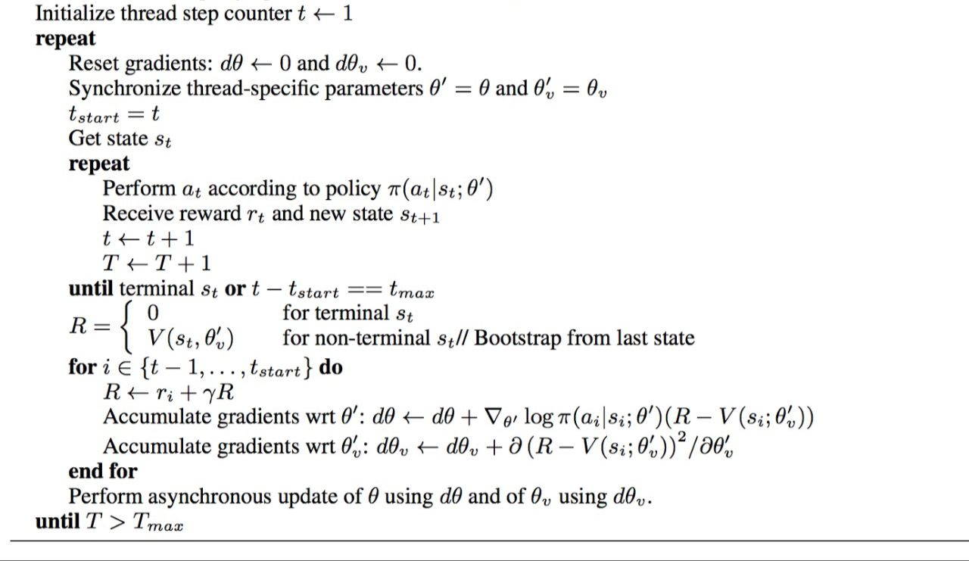
A3C(Asynchronous Advantage Actor-Critic) Algorithm

Slide 8
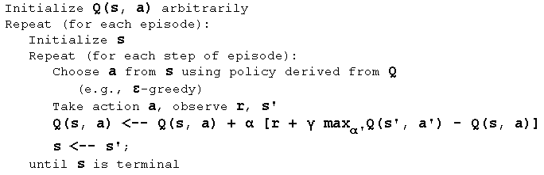
Q-LEARNING ALGORITHM

Slide 9
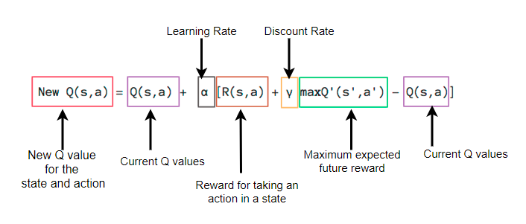
Choosing the Q-VALUE

Slide 10

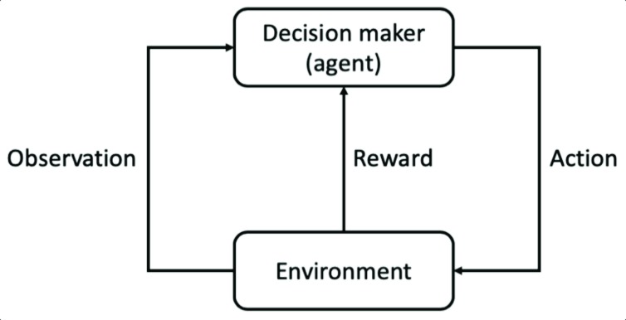
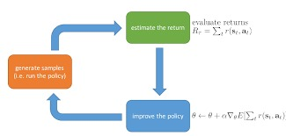
FLOW CHART FOR Q-LEARNING AND A3C

Slide 11
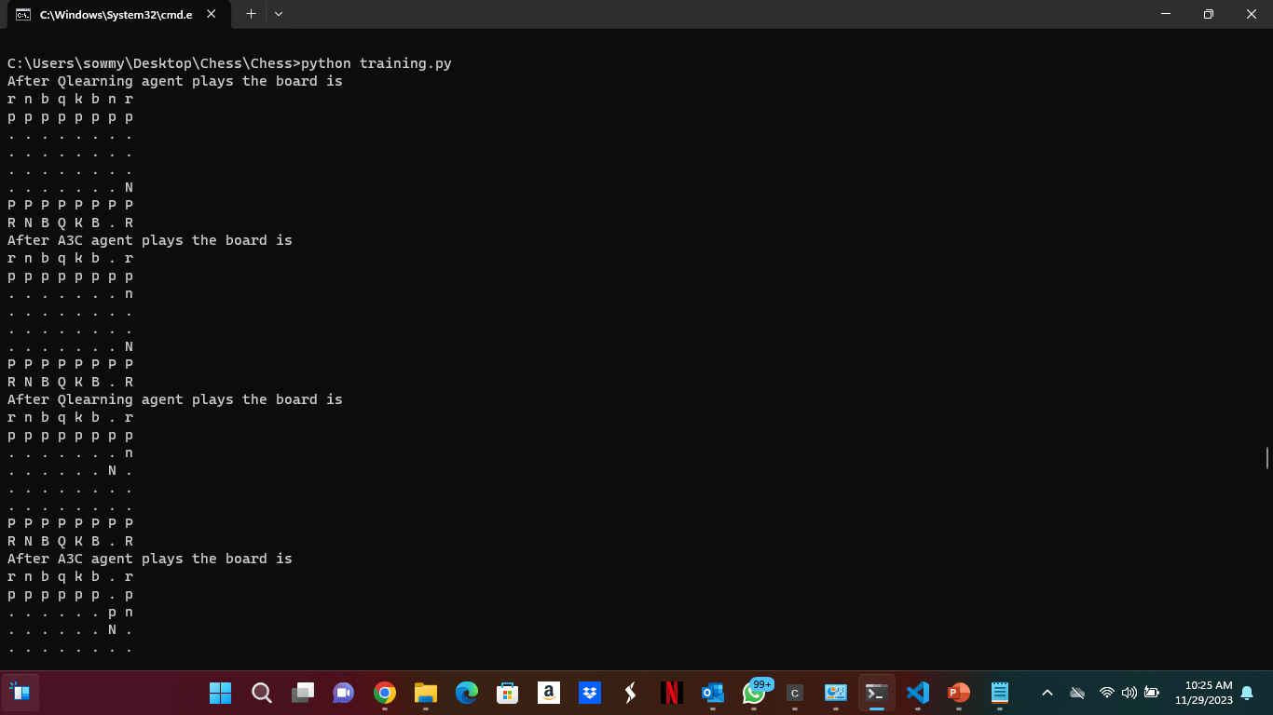
Screenshots of the output

Slide 12
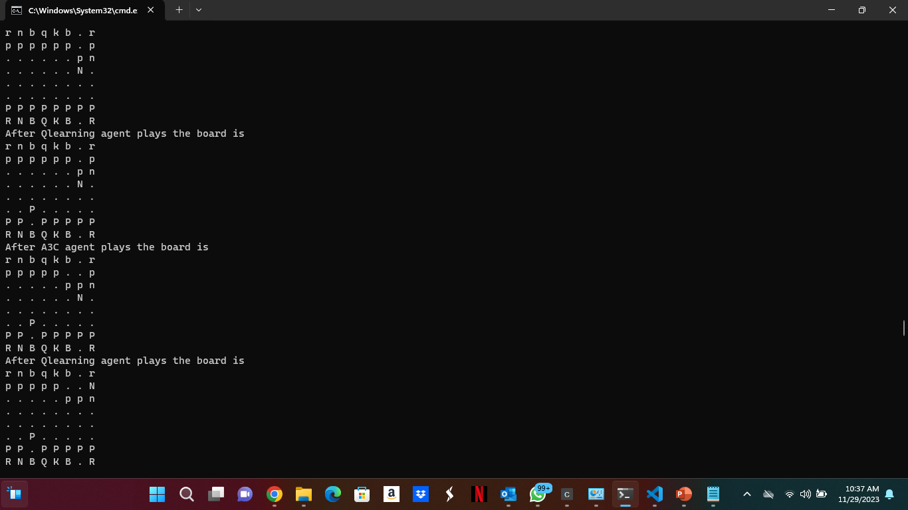
Snapchat of the process

Slide 13
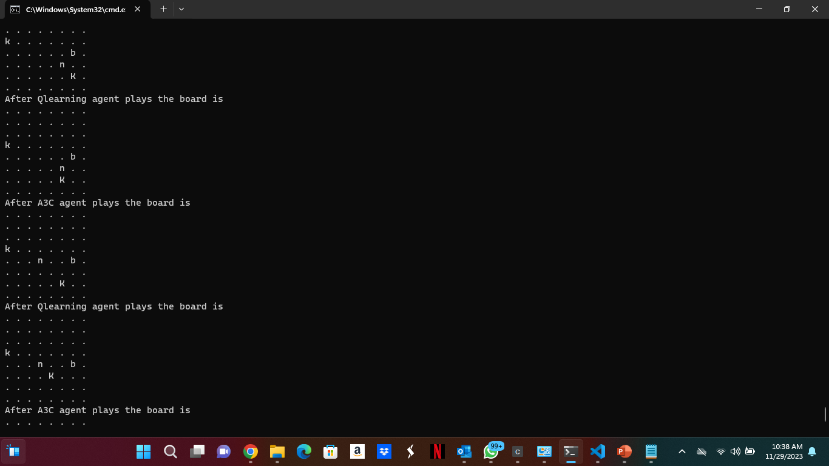
Pre-stages of the chess

Slide 14
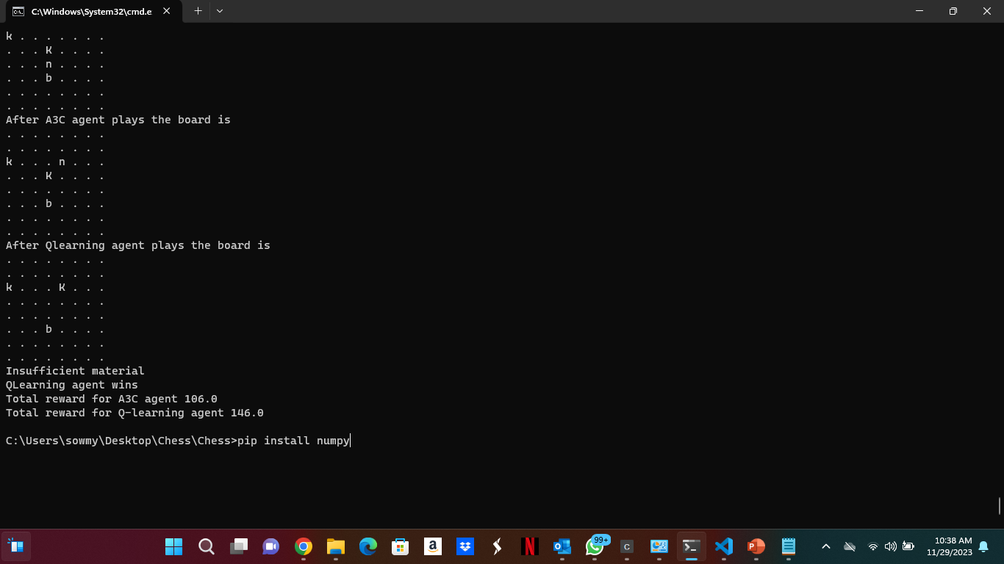
Final output of the chess

Slide 15
Evaluation Methodology:
Reward Maximization. (Chosen the best action at each stage based on the Max Reward)
Accuracy ( 100% accuracy)
Completion Time (<15 seconds)
Scalability (Works better other algorithms too)
Complexity

Slide 16
Deliverables:
Code
Contains the source code, any supporting files used to develop the model
Technical Documentation
Documenting the technical aspects of the Project which includes the Model Architecture, Training Methodology
YouTube Video
The Detailed Video showcasing the working of the chess and results associated with it.
16

Slide 17
Conclusion
The large state space and the constraints of a discrete Q-table representation in chess may provide challenges for Q-learning. However, A3C can manage the complexity better because it makes use of neural networks and asynchronous training.
While Q-learning employs explicit exploration strategies, A3C's exploration is more inherent in the learning process due to its stochastic policies.
This chess game is a battle between the A3C agent and the Q-learning agent . Agent wins depends on the total rewards

Slide 18

Thank you

